Slide 1
Polarization of Light
Well polarized light can be described on the Poincare/Bloch sphere as shown to the right
Ideally, this polarization state should not change during the trip to library and back
Stress on the fiber can cause this polarization to change dynamically with time
Temperature fluctuations
Vibrations from traffic, etc.

Slide 2
Polarization Measurement
Already have measurements to Rantoul
Utilize a polarization analyzer
Consists of:
Waveplates
50:50 Beam splitter
Polarizing Beam Splitters
Detectors

Slide 3
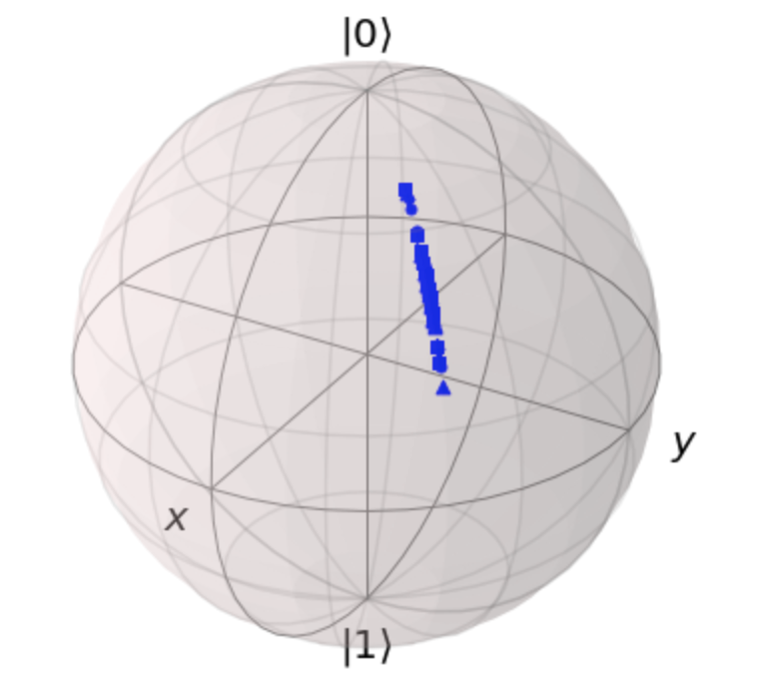
Rantoul Data
We are able to reconstruct the state from the data we get from the analyzer

